Slide 1

Speech & Language Developmental Milestones: A Bilingual/Multilingual Perspective

Slide 2
I. Speech & Language Development
*Milestones are expected for ALL children REGARDLESS of home language*
Speech & Language Terminology
Receptive language = language comprehension, hearing and understanding
Expressive language = language production, language use either verbally (talking) or non-verbally (i.e. signing)
Pragmatics = the use of language, social language; varied within languages and cultures
Articulation & Phonology = the organization and production of specific sounds (phonemes), also known as speech or speech sound production

Slide 3
How does your child hear and talk?* Birth-3 months
Hearing and Understanding
Startles to sounds
Quiets or smiles when you talk
Seems to recognize your voice and quiets if crying
Increases or decreases sucking behavior in response to sound
Talking
Makes cooing sounds
Cries differently for different needs
Smiles at people
*All information from asha.org
https://identifythesigns.org/communicating-with-baby-toolkit/?utm_source=asha&utm_medium=email&utm_campaign=prbacktoschool

Slide 4
How does your child hear and talk? 4-6 months
Hearing and Understanding
Moves eyes in direction of sounds
Responds to changes in tone of your voice
Notices toys that make sounds
Pays attention to music
Talking
Coos and babbles when playing alone or with you
Makes speech-like babbling sounds, like pa, ba, and mi
Giggles and laughs
Makes sounds when happy or upset

Slide 5
How does your child hear and talk? 7 months-1 year
Hearing and Understanding
Plays games like peek-a-boo and pat-a-cake
Turns and looks in direction of sounds
Looks when you point
Recognizes words for familiar objects and people
Turns to own name when you call
Begins to respond to simple words and phrases, such as “No” and “Come here”
Listens to songs and stories for a short time
Talking
Babbles longer strings of sounds, such as mimi upup and babababa
Points to objects and shows them to others
Uses gestures such as waving
Has 1 or 2 words around first birthday, such as hi, dog, dada, mama, or uh-oh
Imitates different speech sounds

Slide 6
How does your child hear and talk? 1-2 years
Hearing and Understanding
Points to a few body parts when asked
Follows 1-part directions such as “Roll the ball” or “Kiss the baby”
Understands simple questions, like “Who’s that?” and “Where’s your shoe?”
Listens to stories, songs, and rhymes for a longer time
Points to the pictures in books when you name them
Talking
Uses many new words
Uses p, b, m, h, and w in words
Starts to name pictures in books
Asks what, who, and where questions, such as “What’s that?” “Who’s that?” and ”Where’s kitty?”
Puts 2 words together, such as “more apple,” “no bed,” and ”Mommy book”

Slide 7
How does your child hear and talk? 2-3 years
Hearing and Understanding
Understands opposite words, such as go-stop, big-little, and up-down
Follows two-part directions, such as “Get the spoon and put it on the table”
Understands new words quickly
Talking
Has a word for familiar people, places, things, and actions
Talks about things that are not in the room
Talks during pretend play, such as saying beep-beep when moving cars
Uses k, g, f, t, d, and n in words
Uses words like in, on, and under
Asks why?
Puts 3 words together to talk about and ask for things

Slide 8
How does your child hear and talk? 3-4 years
Talking
Answers simple who, what and where questions
Says rhyming words, such as hat-cat and silly-billy
Uses pronouns, such as I, you, me, we, and they
Uses some plural words, such as toys, birds, and buses
Asks when and how questions
Puts 4 words together. May make some mistakes, such as ”I goed to school.”
Talks about what happened during the day. Uses about 4 sentences at a time
Hearing and Understanding
Responds when you call from another room
Understands words for some colors, such as red, blue and green
Understands words for some shapes, such as circle and square
Understands for for family, such as brother, grandmother, and aunt

Slide 9
How does your child hear and talk? 4-5 years
Hearing and Understanding
Understands words for order, such as first, next, and last
Understands words for time, such as yesterday, today, and tomorrow
Follows longer directions, such as “Get the box of crayons, find some paper, and pick out three colors”
Understands most of what is said at home and at school
Talking
Says all speech sounds in words. May make mistakes on some sounds, such as l, s, r, v, z, j, ch, sh, and th
Names letters and numbers
Tells a short story
Talks in different ways depending on the listener and place. Uses short sentences with younger children and talks louder outside than inside
Says most sounds correctly except a few like: l, s, r, z, j, ch, sh, th
Uses the same grammar as the rest of the family

Slide 10
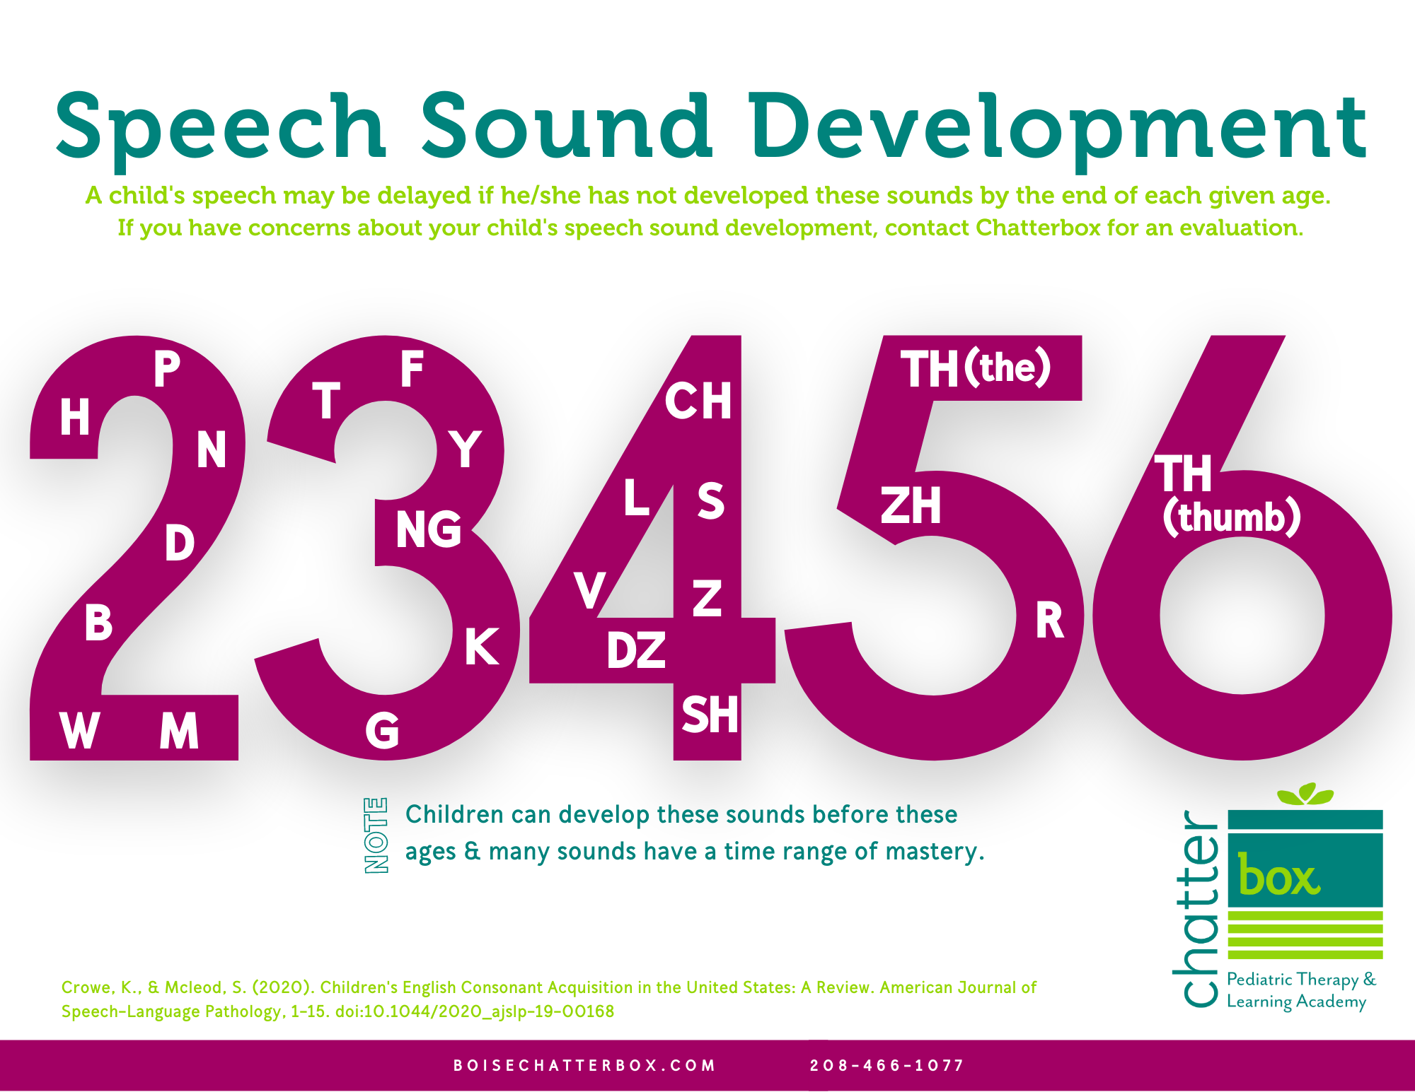
Speech sound development depends on languages and exposure
In English…

Slide 11
How well should someone understand a child’s speech?
Speaking in short sentences to a non-familiar person, your child is understood:
3 year old: approximately 68%
3 1/2 year old: approximately 78%
4 year old: approximately 86%
4 1/2 year old: approximately 91%
5 year old: approximately 94%
6 year old: approximately 97%
*https://www.boisechatterbox.com/blog/speech-sound-development-chart

Slide 12

Widely spoken language in the united states
Spanish, Chinese (Mandarin, Cantonese, Hokkien, etc), Tagalog (Filipino). Vietnamese, French & French Creole, Arabic, Korean, Russian and German
https://bilinguistics.com/articulation-norms-for-spanish-and-English/
https://www.asha.org/siteassets/uploadedfiles/multicultural/mandarinphonemicinventory.pdf
https://bilinguistics.com/filipino-tagalog-speech-sounds/
https://bilinguistics.com/vietnamese-speech-and-language-norms/
https://www.bonjourspeech.com/speech-sound-development
https://www.asha.org/siteassets/uploadedfiles/multicultural/arabicphonemicinventory.pdf

Slide 13
DUAL LANGUAGE LEARNERS: BILINGUALISM & MORE
Being multilingual DOES NOT make speech and language development, delays, or disorders any slower or any more affected than being monolingual
NEVER follow the advice to drop a language in the belief that it will simplify things, or support faster development in one language. There is NO SCIENTIFIC EVIDENCE to support this advice. Do not accept advice to drop a home language. That is your family, your culture, your life. That is not for anyone to take away.
A dual language learner is NOT becoming a monolingual speaker in each of their langauges. Their languages communicate with each other in what is called “processes of bilingualism.”

Slide 14
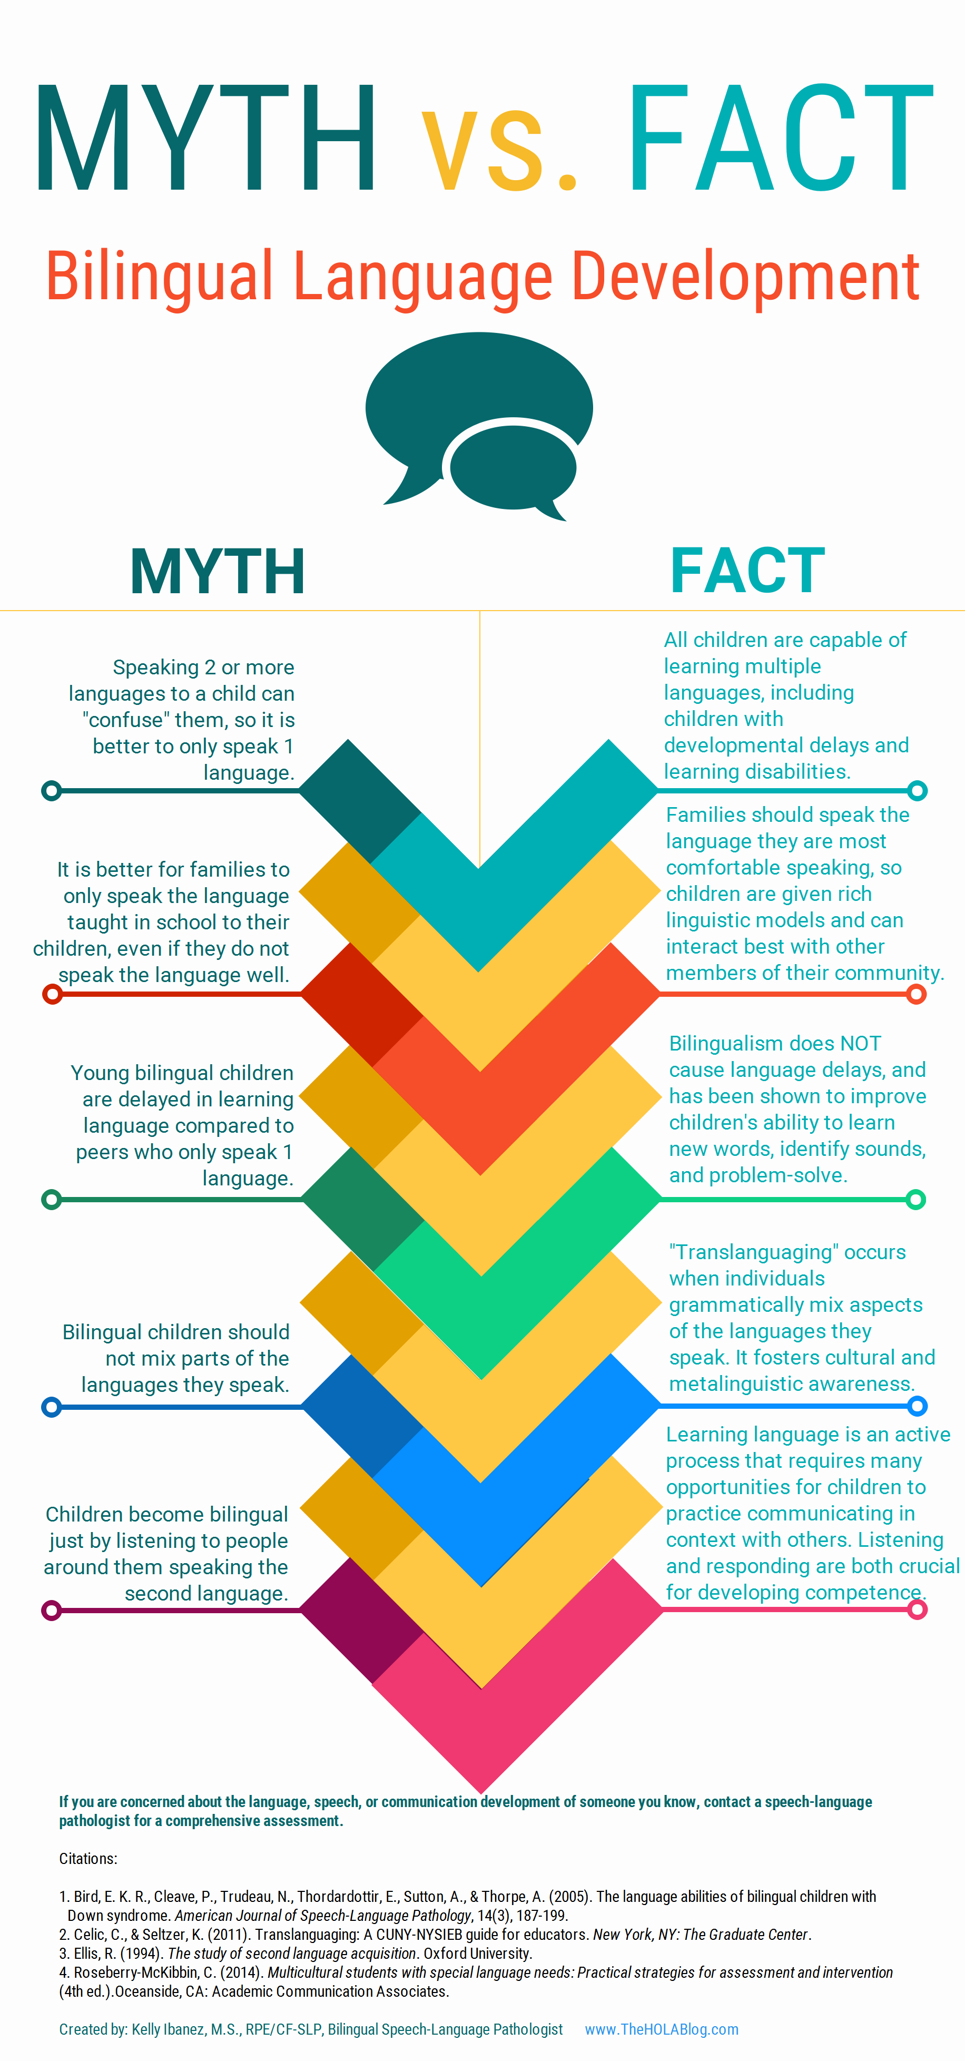
*Theholablog.com

Slide 15
Dual language learners
Develop their early vocabulary at the same rate as monolingual children (Pearson, 1993)
Have similar early language milestones (i.e. single words, lexical support, two-word phrases) (Pearson & Fernandez, 2001)
Have similar conceptual scores (Pearson, 1998)
1 in 5 children in the U.S. speaks a language other than English in the home (2020 census)
*From bilinguistics.com

Slide 16
If a dual language learner has a true language delay…
Bilingualism did NOT cause it
They would have it, even if the family was monolingual
Hearing many languages did NOT confuse them
No need to stop bilingualism
It is possible, they won’t “catch up with time”
Speech therapy will help
Bilingualism will NOT harm their therapy progress
@laleo.bilingual.therapy

Slide 17
Individuals with disabilities education act 2004 (most recent amendment 2015)
The Individuals with Disabilities Education Act (IDEA) is a law that makes available a free appropriate public education to eligible children with disabilities throughout the nation and ensures special education and related services to those children.
The IDEA governs how states and public agencies provide early intervention, special education, and related services to more than 7.5 million (as of school year 2020-21) eligible infants, toddlers, children, and youth with disabilities.
Infants and toddlers, birth through age 2, with disabilities and their families receive early intervention services under IDEA Part C. Children and youth ages 3 through 21 receive special education and related services under IDEA Part B.
https://sites.ed.gov/idea/about-idea/

Slide 18
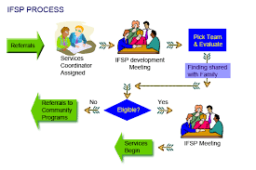
IFSP: Individual family service/support plan

Slide 19
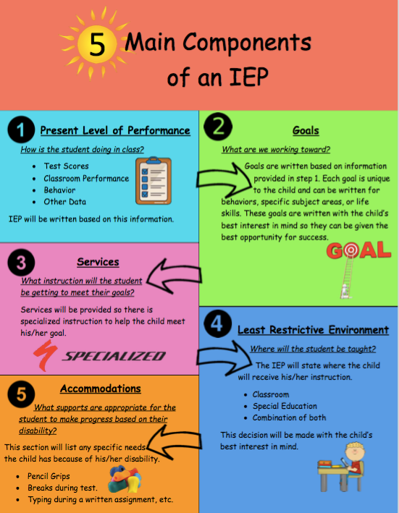
IEP: Individual education plan
spedadvisor.com

Slide 20
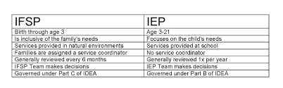
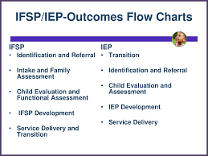

Slide 21
How are the services provided?
Part C—IFSP
Generally home-based, also to participate in early-childhood education center such as Early Head Start.
Part B—IEP
Generally pull-out or classroom-based in local public elementary school in addition to Head Start.

Slide 22
QUESTIONS? COMMENTS ☺ THANK YOU!!
Follow on Instagram:
@bilingualslpllc
@bilingualplaydate
@unlearnwithme.theslp
@theholaclinic
@laleo.bilingual.therapy
@phuonglienpalafox
@thecld_slp
@jrc_theslp
@code.switch.slp
@aaefortheslp

Slide 23
Other info sources & citations
https://www.theinformedslp.com/review/no-sl-ps-were-in-the-room-where-it-happened?fbclid=PAAaYVd2FoEUWvffRLQGjm5ffhQUm6hd7YwbqT4in21i0hXGMQn2fahiqjVLc_aem_th_AZR86RvJMg5MQJqQlQGlT1K86qtCF7tk9d3u8KWt5IWv16Xnl8W1DSevWVhD2xmCb1o
https://identifythesigns.org/communicating-with-baby-toolkit/?utm_source=asha&utm_medium=email&utm_campaign=prbacktoschool

